Slide 1
City of Maple Ridge i-Tree Pilot Study September 18, 2015
Notes:
Thanks, rod…

Slide 2
Outline
Background
Potential City Applications
i-Tree Pilot Studies
Summary

Slide 3
Background
What Kind of Natural Asset Inventory Initiatives has Maple Ridge already completed or commenced?
Watercourse & water features mapping
Greenway corridor mapping
Significant & Unique Ecosystems mapping
Terrestrial elevation mapping
SPR Setback Classification mapping
Municipal Re-forestation mapping
Natural Capital Inventory mapping studies pilot studies with BCIT

Slide 4
Background
Why Is Maple Ridge Interested in Natural Asset Mgmt
Well suited to work with its natural resources because many of them are located on municipal owned lands
Maple Ridge is fortunate to be able to work with OCP policies, regulatory tools, and community based management strategies that emphasize pro-active and sustainable development practices
Maple Ridge surrounded by Crown Lands that are forested
History of working smart using pro-active planning & strategies

Slide 5
Background
How Is It Being Used Elsewhere to Help Local Gov
Global applications
How different cities are using these tools (e.g. New York Toronto, Ottawa, Surrey, Vancouver, etc.)
Physical Capital vs. Natural Capital

Slide 6
Background
Diamond Head Consulting Ltd. presentation focused on:
What Green Infrastructure is
How different cities are using these tools (e.g. Metro Van: RGIN; City of Surrey, Toronto, etc.)
Introduced us to various i-Tree tools and uses
Pilot Study - i-Tree Canopy
GIS Pilot Study - various

Slide 7
i-Tree Tools
The i-Tree suite of software includes:
i-Tree Eco
i-Tree Streets
i-Tree Hydro
i-Tree Vue
i-Tree Design
i-Tree Canopy
i-Tree Species
i-Tree Pest Detection Module
i-Tree Storm
For more info on how to use these tools, visit: http://www.itreetools.org/resources/videos.php

Slide 8
Municipal Pilot Study Areas:
Parks (conservation areas and active parks)
Street Trees in boulevards and rights-of-ways
City-owned properties (e.g. in Silver Valley)
Watershed/Area Plan or Municipal Scale Assessment and Performance Review

Slide 9
Applications: i-Tree Streets
Uses tree inventory data to quantify the services and dollar value of annual benefits, as well as monitor performance measures such as:
energy conservation implications;
air quality improvements/losses;
CO₂ reduction / green house gas monitoring
stormwater volumes, release rates, controls
Property value increases

Slide 10
Applications: i-Tree Streets
Notes:
MR already has an existing inventory of street trees, so all we would need to do is add height and diameters to the data tables, and we could extrapolate natural capital values.

Slide 11
Applications: i-Tree Canopy
Web-based program that uses Google Maps to estimate land cover type, pervious vs. impervious surfaces
Percentage types can be translated to determine stormwater infiltration capability, air pollution reduction and carbon sequestration opportunities
Town Centre Example:
24.4% Tree Cover
31.9% Paved Surface
16% Grass
25.1% Buildings
(Remaining percentage is pool, shore, gravel areas)

Slide 12
Applications: i-Tree Canopy
Generates random sampling points to provide tree cover data,
It uses the parameters you’ve selected (region, currency) to extrapolate the following data:
carbon monoxide removal
nitrogen dioxide removal
ozone removal
sulfur dioxide removal
PM_{2.5} removal
PM₁₀ removal
carbon dioxide sequestered annually
Notes:
These percentages can then be translated to determine air pollution reduction and carbon sequestration.

Slide 13
Canopy Pilot Study – Silver Valley

Slide 14
Canopy Pilot Study – Silver Valley
Compared land cover in 1994, 2004, and 2011
1994
2004
2011
Notes:
The program randomly generates the points, you enter the type of cover class you want to identify, then you can export those points into Google Earth to compare the change over the years.

Slide 15
Canopy Pilot Study – Silver Valley
Findings:
Table 1 – Comparison of Land Cover for 1994, 2004 and 2011
Cover Class | % Cover 1994 | % Cover 2004 | % Cover 2011
Tree | 82.2 | 78.6 | 69.7
Building | 2.6 | 3.0 | 6.2
Impervious | 3.2 | 3.6 | 10.2
Grass | 11.8 | 14.8 | 13.8

Slide 16
Canopy Pilot Study – Silver Valley Monitor Natural Asset Gains/Losses
Table 2 – Comparison of Tree Benefit Values for 1994, 2004, and 2011
Tree Benefit Description | $ Value 1994 | $ Value 2004 | $ Value 2011
Carbon Monoxide removed annually | $ 51 | $ 49 | $ 43
Nitrogen Dioxide removed annually | $ 136 | $ 130 | $ 115
Ozone removed annually | $ 6,902 | $ 6,599 | $ 5,858
Particulate matter <2.5 microns removed annually | $ 35,697 | $ 34,130 | $ 30,299
Sulfur Dioxide removed annually | $ 18 | $ 17 | $ 15
Particulate matter >2.5 microns and <10 microns removed annually | $ 4,850 | $ 4,637 | $ 4,116
Carbon Dioxide sequestered annually in trees | $ 127,737 | $ 122,192 | $ 108,704
Subtotal of annual benefits | $175,391.00 | $167,754.00 | $149,150.00
Carbon Dioxide stored in trees (not an annual rate) | $ 3,709,569 | $ 3,546,710 | $ 3,148,610
Total | $3,884,960.00 | $3,714,464.00 | $3,297,760.00

Slide 17
Canopy Pilot Study – Silver Valley
Table 3 – Summary of Changes in Cover Class and Tree Benefits
 | Change in 10 years (1994 to 2004) | Change in 17 years (1994 to 2011)
Cover Class
Tree | -3.6% | -12.5%
Building | 0.4% | 3.6%
Impervious | 0.4% | 7%
Grass | 3% | 2%
Tree Benefit
Carbon Monoxide removed annually | -$2.00 | -$8.00
Nitrogen Dioxide removed annually | -$6.00 | -$21.00
Ozone removed annually | -$303.00 | -$1,044.00
Particulate matter <2.5 microns removed annually | -$1,567.00 | -$5,398.00
Sulfur Dioxide removed annually | -$1.00 | -$3.00
Particulate matter >2.5 microns and <10 microns removed annually | -$213.00 | -$734.00
Carbon Dioxide sequestered annually in trees | -$5,545.00 | -$19,033.00
Subtotal of loss in annual benefits | -$7,636.80 | -$26,240.90
Carbon Dioxide stored in trees (not an annual rate) | -$162,859.00 | -$560,959.00
Total | -$170,496.00 | -$587,200.00
Notes:
In ten years, a loss of about 4% tree cover equates to an approximately loss of $170,500. In 17 years, a loss of about 13% tree cover equates to an approximate loss of $587,200.
Note that this is only the values calculated by the i-Tree Canopy program. If you consider the additional services such as climate regulation ($1709/ha), flood protection ($1,502/ha), water supply ($1,809/ha), pollination ($1,669/ha) and recreation ($127/ha), the values of the ecosystem services provided by the trees in increased significantly.

Slide 18
iTree Canopy
Difference in land cover totals from 2000-2011
Tree | Grass | Building | Impervious
-10.0% | -0% | +5.2% | +4.8%
Loss of Estimated benefits from 2000-2011
Carbon Monoxide | Nitrogen Dioxide | Ozone | Fine Particulate Matter | Sulfur Dioxide | Coarse Particulate Matter | Annual Carbon Dioxide (seq) | Total Carbon Dioxide Storage
6.58 | 17.48 | 885.54 | 4579.81 | 2.31 | 622.23 | 15923.87 | 475921.17
Notes:
There are many different ways to display quantifiable data, not all of which need to be graphs and graphs of numbers
This is dependent on the level of change in a study, but because we lost/gained a significant number we are able to display charts as a means of visual representation of our data
The Building class cover is any roofed structures, so this can include sheds and detached garages., while impervious is all streets, sidewalks, and driveways that are pavement covered.
The grass land cover did change from 2000-2004 but ended up equaling out due to cleared land being replaced with impervious or building covers.
Benefits are in Canadian Dollars, as you can see the carbon storage, which is a one time loss, accounts for a large percentage of total benefit dollars lost.
Many of our species (Douglas fir, western hemlock, maple (big leaf and red)) are high benefit trees for ground ozone and particulate matter 2.5 (fine), considering this information, it would be interesting to see losses and composition in hedgerows between agricultural land in Maple Ridge as well, as many fields lay fallow in circulation, without vegetation cover

Slide 19
iTree Canopy
Notes:
Earlier years start on the left, to the latest in the right (green to red)
10% loss of tree cover
Grass land cover class also included bare ground, so grass cover class temporarily increased as the land was cleared, then levelled out as the land was replaced with buildings and roads
Impervious and building cover increases and simultaneously and equally

Slide 20
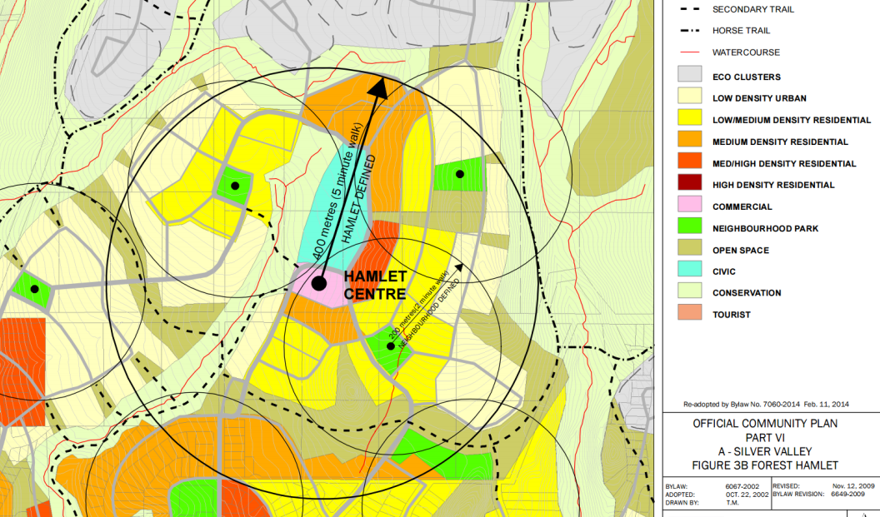
Canopy Pilot Study – Silver Valley
Notes:
What’s interesting about Silver Valley is that it’s approximately 640 ha, and the City owns about 170 ha. There is a great opportunity to direct the development within the Forest Hamlet to set an example for the developers and conserve as many trees as possible in order to not lose all of the ecosystem services that are currently going un-accounted for. If you were to develop these lands and only consider the cost of new infrastructure for roads, sanitary systems, storm drainage and water, then you may come up with a value to make it profitable to develop. However, if you consider the services being provided by the trees that would be lost each year, then that profit quickly becomes a loss for the city overall.

Slide 21
GIS Pilot Studies
Replicated Silver Valley study using 1000 points and found the same change in land cover
Tree Canopy study for all of Maple Ridge
Worked with i-Tree Design, i-Tree Eco, and i-Tree Hydro (beta)
Notes:
.

Slide 22
Applications: i-Tree Hydro (beta)
Simulation tool that quantifies effects of tree cover and impervious cover on streamflow and water quality
Uses elevation, land cover, weather data, other model parameters
Can contrast runoff volume from an existing land cover with runoff from an alternative case of land cover
Current issues: Canadian weather data is not compatible

Slide 23
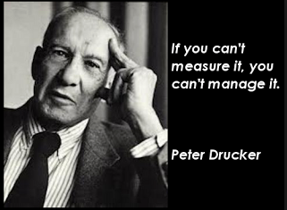
Summary
i-Tree Canopy is an efficient way to monitor tree cover in a given area
Information can be used to set goals and monitor progress towards or away from them
Ecosystem service information should be integrated into land use decisions
Next Steps…?

