Slide 1
City of Maple Ridge
Green Infrastructure Overview
Challenges & Opportunities
MEMC April 12, 2018
Notes:
Thanks, rod…

Slide 2
Background
  Maple Ridge – Overview of Green Infrastructure Management Strategy Framework
  Ongoing Challenges/Strengths
  Collaboration and Partnerships
  Next Steps

Slide 3
Short Term Priorities for A Green City
  Env. Advisory Committee (EAC) short & long term priority with Council Endorsement for municipal green infrastructure study
  Scoping Report on Green Infrastructure Management Strategy Report and Consultation Process for Council – 2018
    Why is Green Infrastructure (GI) important?
    Inventory and Evaluation of Green Infrastructure
    How and where can we improve municipal policy and practices?
  Improve Awareness and Consultation through:
    Guest Speakers and Subject Matter Experts
    Public Consultation and Workshops/Charrette Processes
    Ongoing collaboration with GI partners
  4. Providing new and better information to help improve decision making processes, planning, and best practices

Slide 4
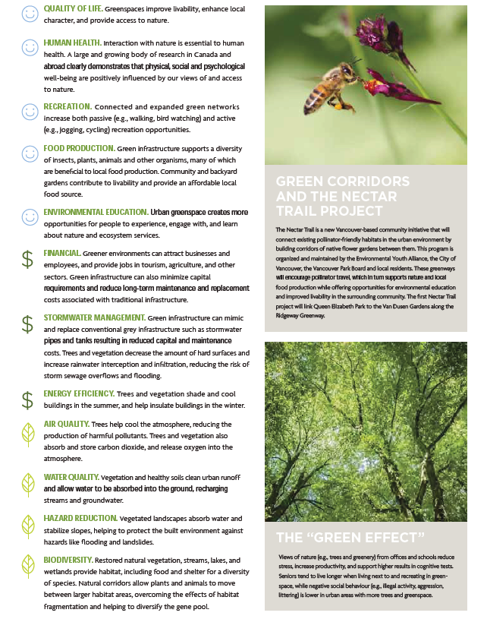
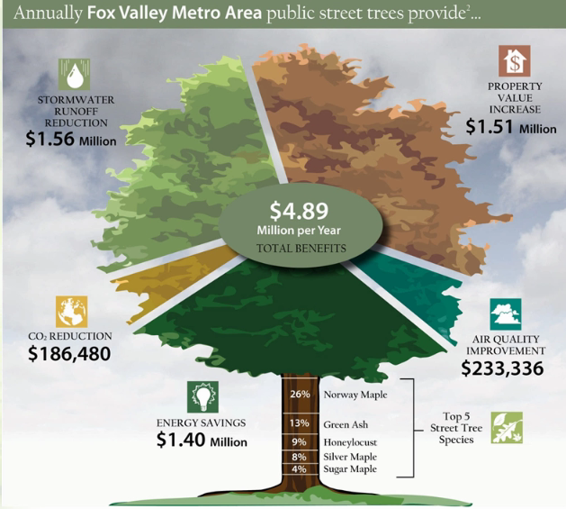
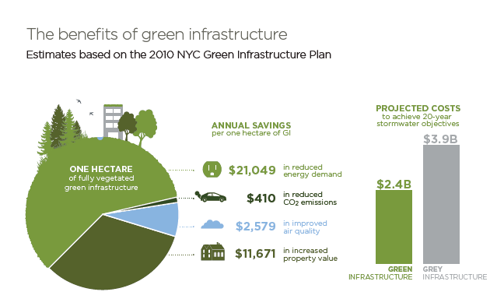
Step 1. Awareness Campaign. Why Is A Green Infrastructure Mgmt Strategy Important For Maple Ridge?

Slide 5
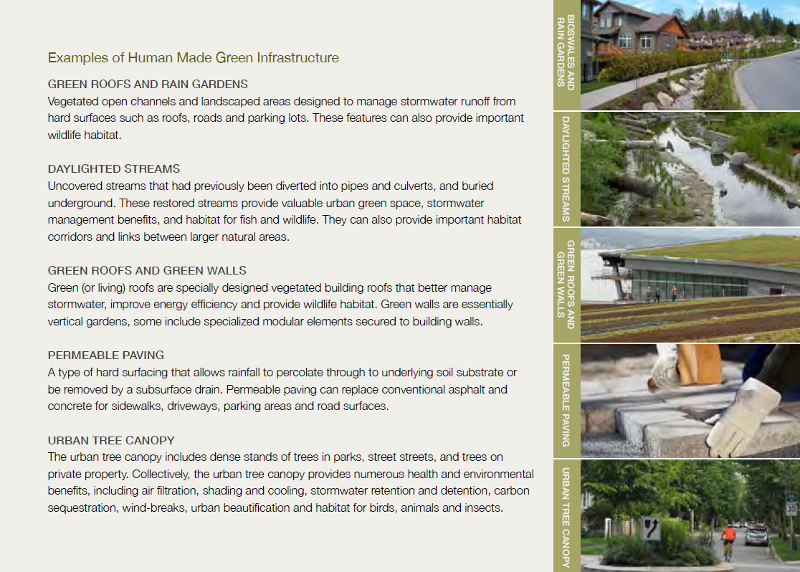
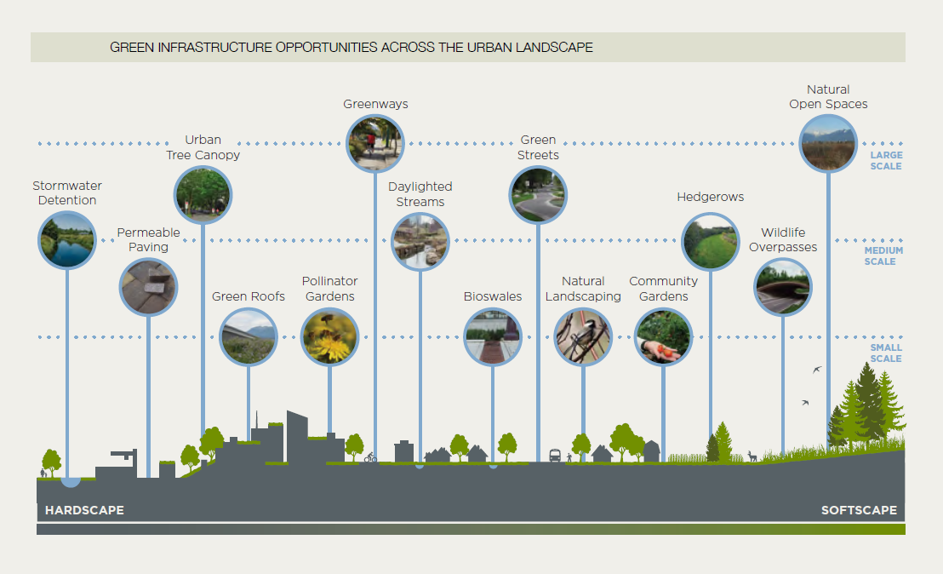
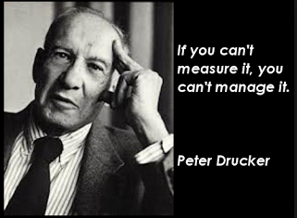
Step 2. Identify Locations, Condition, & Measure Benefits of Green Infrastructure

Slide 6
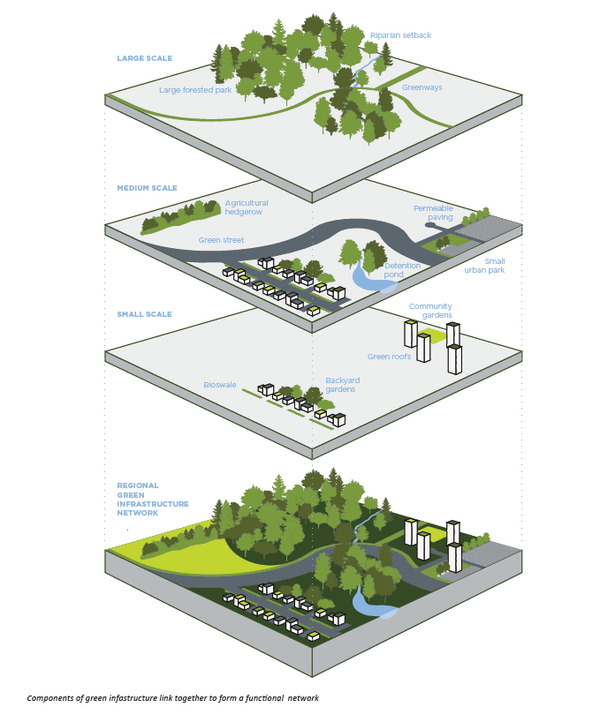
Different Scales/Types Of Green Infrastructure
What Is Natural Capital ?
Existing Inventory
Streams & Water features
Unique and sensitive ecosystems (SEI)
Steep slopes/topography
Trails Network
Soils & Geology
Street Trees
Protected lands/parks
Ongoing Inventory
Forest Lands (ongoing)
Green Hubs & corridors
Drainage Bio-Engineering
Enhancement Projects
Wildlife Networks
Food Hubs
Bio-diversity values
*Invasives (Threats)
Pervious/Impervious

Slide 7
Maple Ridge Inventory & Evaluation
Studies for Green Infrastructure
  BCIT/CMR Urban Forest Municipal Inventory
  iTree Evaluation of Maple Ridge Watersheds, Urban Areas, and Community Forest Areas on City Lands
  UBC Gradient Study & Urban Forestry Research
  CMR Best Land Use and GI Study of Municipal Forested Lands in Silver Valley Area
  Ongoing Studies – MV Urban Forestry Initiative, Ecological Health & SEI inventories, Local ISMP Studies, Area and Neighborhood Level Plans

Slide 8
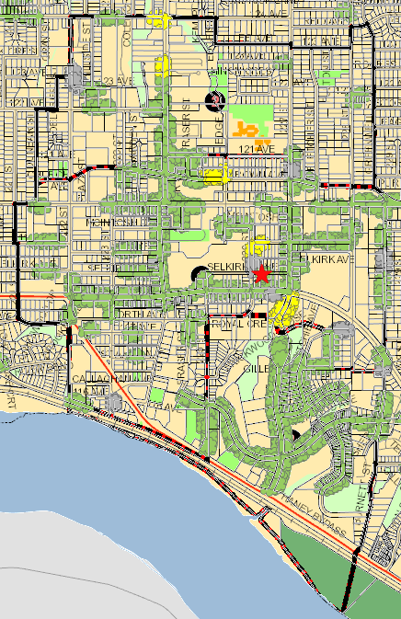
Applications: i-Tree Streets
Notes:
MR already has an existing inventory of street trees, so all we would need to do is add height and diameters to the data tables, and we could extrapolate natural capital values.

Slide 9
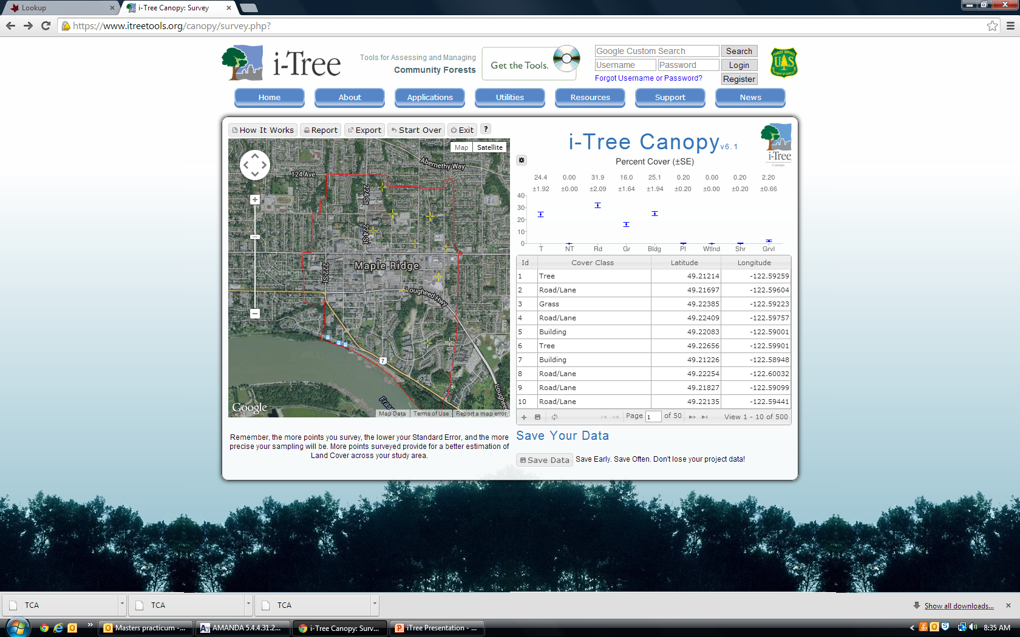
Applications: i-Tree Canopy
Web-based program that uses Google Maps to estimate land cover type, pervious vs. impervious surfaces
Percentage types can be translated to determine stormwater infiltration capability, air pollution reduction and carbon sequestration opportunities
Town Centre Example:
  24.4% Tree Cover
  31.9% Paved Surface
  16% Grass
  25.1% Buildings
(Remaining percentage is pool, shore, gravel areas)

Slide 10
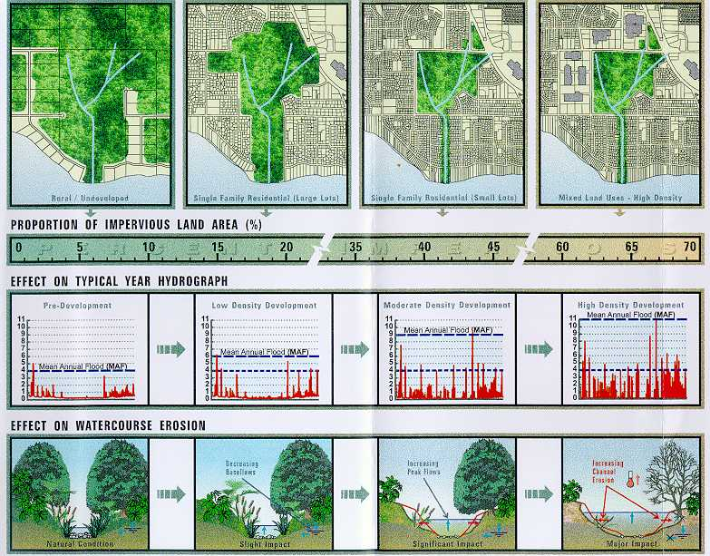
Integrated Stormwater Management Plans
Integration of Services From Natural Assets & Green Infrastructure

Slide 11
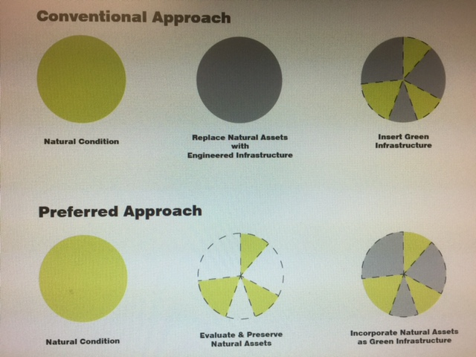
Step 3. Identify Challenges & Opportunities For Green Infrastructure
Replacing natural assets with engineered infrastructure
vs.
Working with nature and incorporate natural assets as green infrastructure

Slide 12
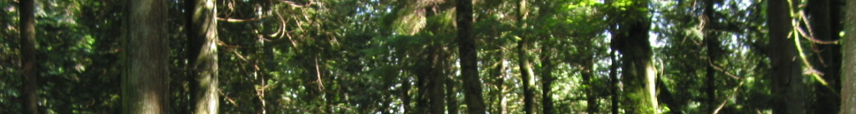
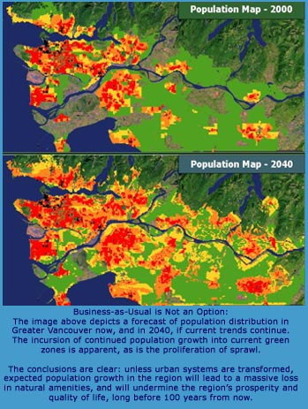
Planning For Change
Increasing Population around 78,000 for Maple Ridge in 2016 possibly reaching 132,000 by 2040
Complex topography with cumulative impacts on natural landscape, resources, and assets
Climate change and global influences increasing concerns about storm events, flooding, drought, wildfire, local food production, peak oil, soil erosion.
Increasing development pressure, fragmentation of landscape, and impacts on ecological health
Maple Ridge
Maple Ridge
Notes:
Staff

Slide 13
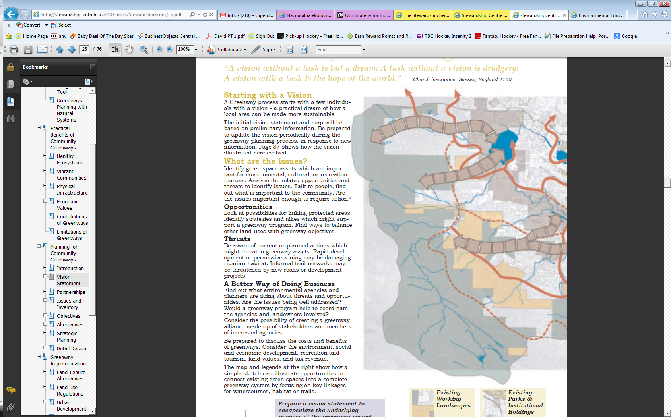
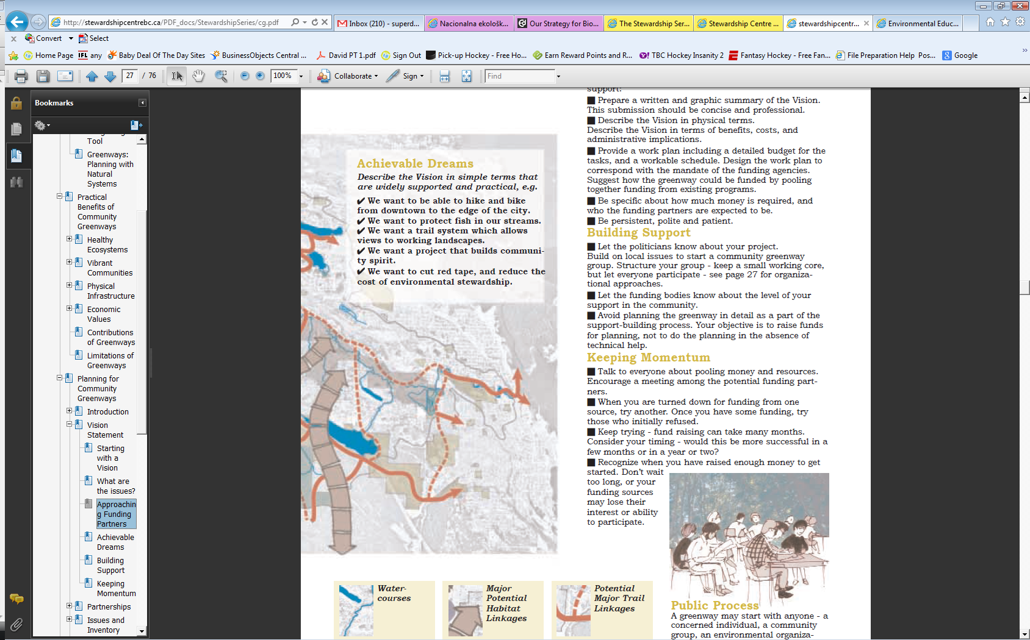
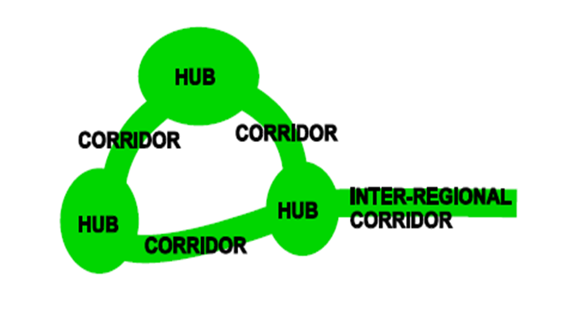
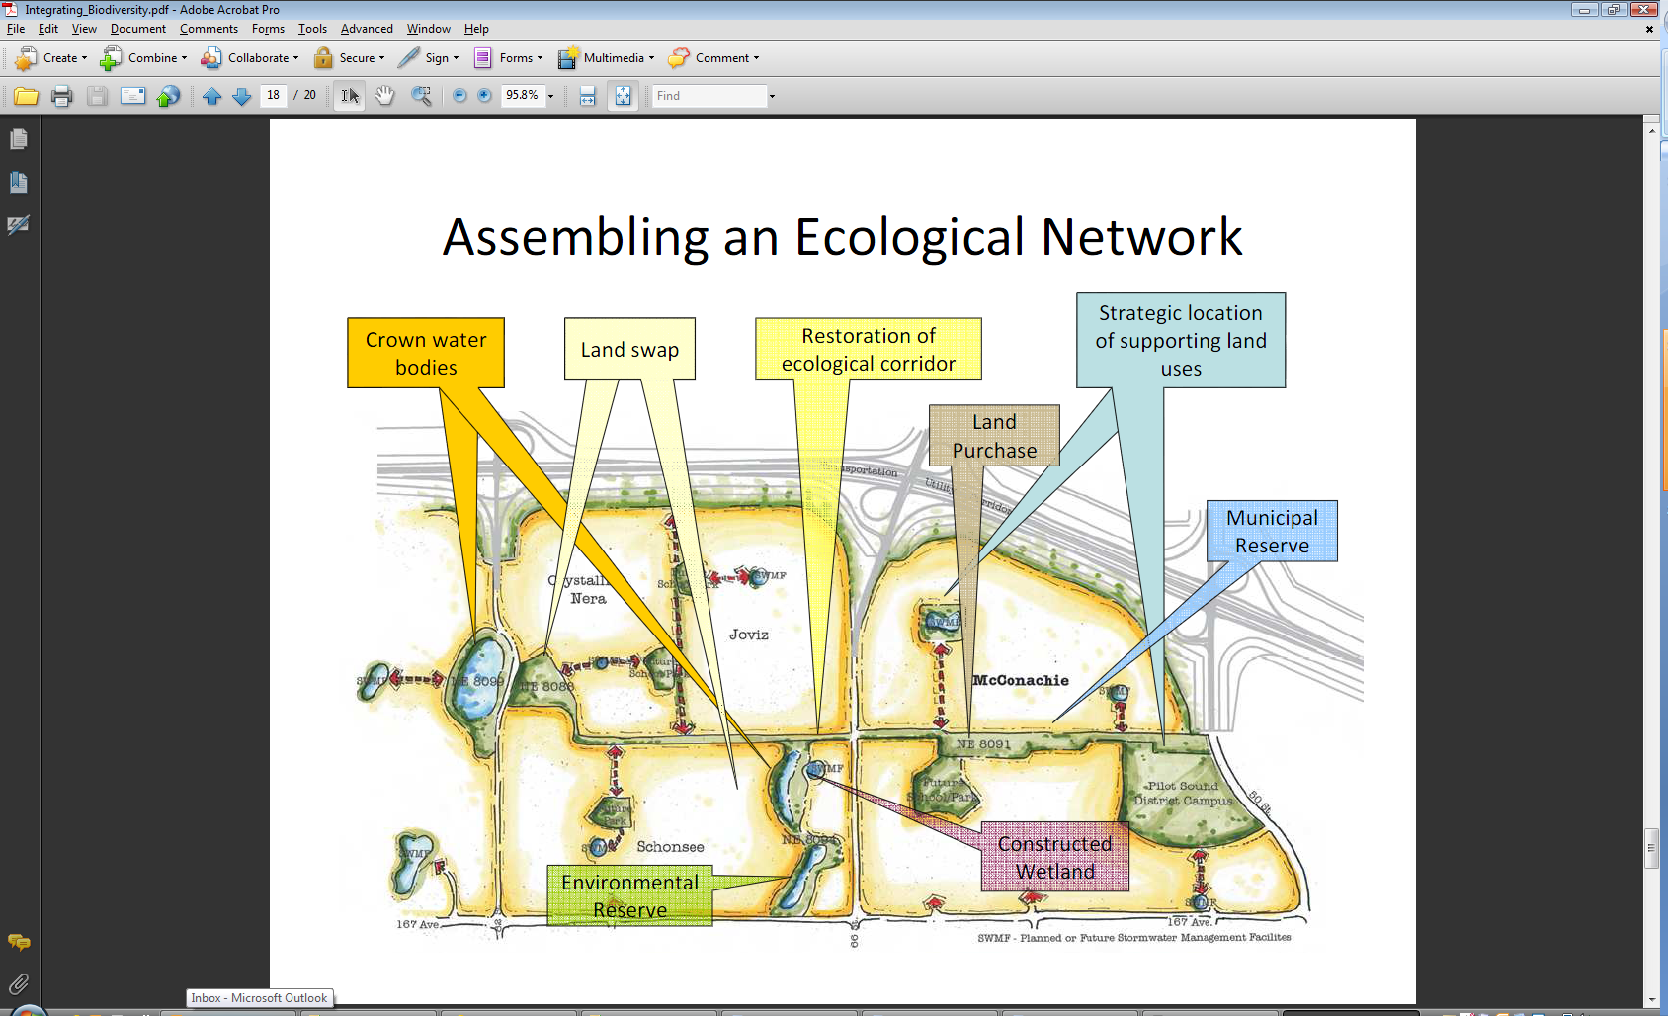
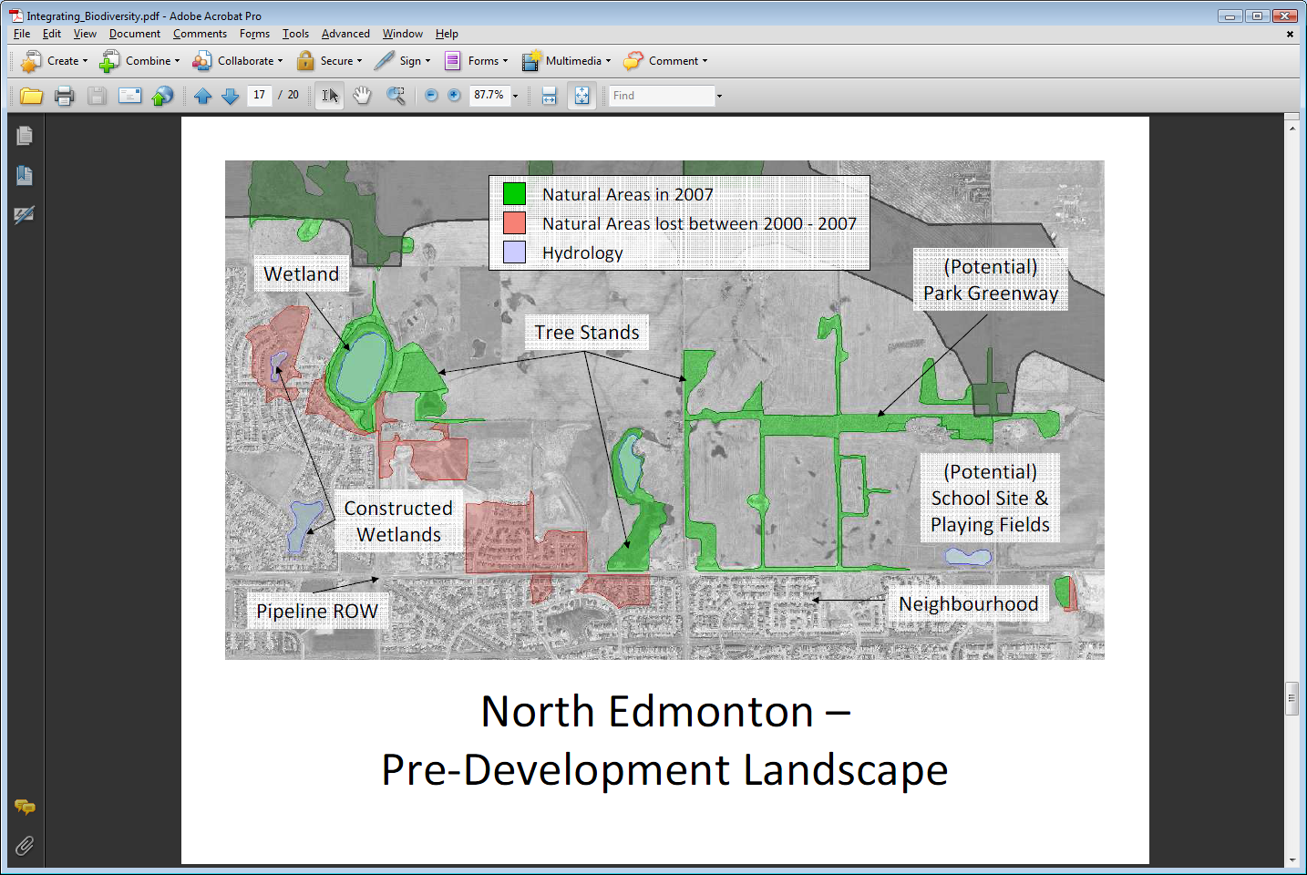
Title
Ecological Network Management Priorities
Elements of an Ecological Network
Regional Biodiversity Core Areas
• Biodiversity Core Areas
• Stepping Stones and linkages
(natural & semi-natural)
Greenway Corridors & Hubs
Tools for Consideration

Slide 14
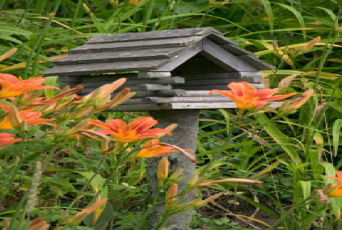
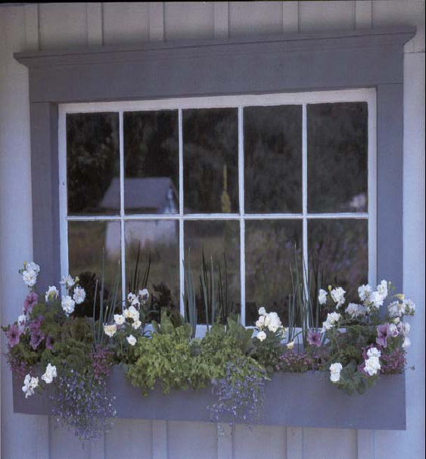
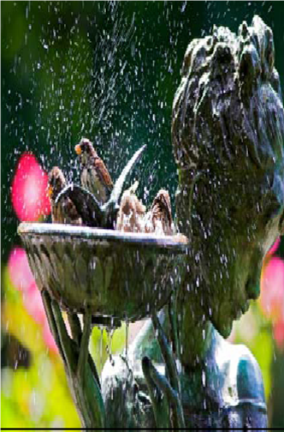
Green Infrastructure in Urban Areas
Urban Ecology: Naturescaping in Backyards
Art in The Park
Stewardship Programs: Adopt a Creek/Park
Ecology Interpretive Learning Centres
Community Gardens
Notes:
Maple Ridge is growing rapidly – between 1996 and 2001, the population grew by 12.5% to 63,169. That means that every month, an average of 117 new residents made Maple Ridge their home, and this trend shows no sign of abating. Our challenge is to ensure that this growth results in positive change that continues to build a modern, complete city, while maintaining the small town ambience, historic character, and beautiful natural surroundings that make Maple Ridge such a great place to live.
Enhanced retail. Most neighborhood retailers (supermarkets, drugstores, coffee houses,
convenience foods) rely on counts of “rooftops” to determine where to invest. The customer
base guides the location and size of new stores and the renovation and expansion of existing
ones. Infill and higher densities will add rooftops, making communities more inviting for
retailers.
Move-down buyers. In many communities there will be individuals and families who would
like to move to a smaller, brand new home while staying in their neighborhood. New infill
development can offer that opportunity.
Property value impacts. While the perception may be that higher density development will
lower property values, the opposite is generally true, especially if the new housing is for-sale.
New construction will always sell for a higher per-square-foot price than older housing,
increasing sales prices in the area. A new 1400 square foot house on a small lot will sell for
more than an old 1400 square foot house on a large lot, indicating that people are willing to pay
high prices to live in that neighborhood. This is good for property values.
Promise of sale for redevelopment. If land can be redeveloped at higher densities, local
owners of large lots may see potential future profit in redevelopment. In most areas of the
county it is not economical to tear down an old house and replace it with a single new house. It
may, however, be profitable to replace one old house with three or four, making the land under
the old house quite valuable. Owners of large lots can become advocates of higher densities if
they see development potential in their property.
Property tax impacts. New construction added to the tax rolls spreads the burden of paying off
existing city and school district bonds.

Slide 15
Key Challenges
Lack of awareness about the functionality & value of GI to decision makers, residents, & tax payers
Traditional thinking/practices by decision makers, administration, and development stakeholders
Lack of financial tools for dealing with GI both in terms of public/private space requirements and ongoing maintenance/life cycle costs
Gap between policy/plans and implementation - need for neighborhood level plans, regulations, appropriate design standards and best practices

Slide 16
Key Challenges
Lack of experience and confidence from stakeholders about design, implementation, liabilities, and costs
Limited space, natural assets, and resources to address GI concerns within town centre and existing urban infill areas with focus on denser smaller sites
Coordination amongst various departments, consultants, and appropriate solutions that consider on site and off site requirements

Slide 17
Key Opportunities
Consistent with existing municipal objectives, corporate strategies, and OCP policies
Abundance of public and private owned lands with natural assets that are intact
Retrofit opportunities for town centre and surrounding older urban infill areas
Existing municipal investments in progressive regulations and plans for protection & management of natural asset & green infrastructure BMPs

Slide 18
Key Opportunities
Climate change impacts and extreme weather events trigger the need for ecological resiliency
Accountability with respect to best use of public lands, looking after public interests, and costs to public taxpayers
Liveability and sustainability concepts still relevant and alive in planning and consultation processes
Awareness and Pride by community stakeholders in importance of having a great place to live, work, and play.

Slide 19
Key Opportunities
Ongoing research and collaboration with various organizations including Metro Vancouver, UBC, BCIT, and SFU helping reinforce the value of green infrastructure, measuring its services, and helping with education and outreach
Smart, cost effective, and functional lessons learned from other communities/experts.

Slide 20
Step 4. Identify Natural Asset & Green Infrastructure Management Strategies
Inter-Dept. Cooperation to help determine appropriate plans, design standards / guidelines, and integration of ideas
Ongoing Lessons/Research: Learning from others
Funding Framework moving towards municipal business planning & annual budgets for GI rather than using a piecemeal LAS approach
Education & Outreach – Enviro. Advisory Committee, Metro Vancouver, BCIT/UBC communications initiatives
Partnerships & Collaboration with appropriate stakeholders is required for holistic natural asset and green infrastructure

Slide 21
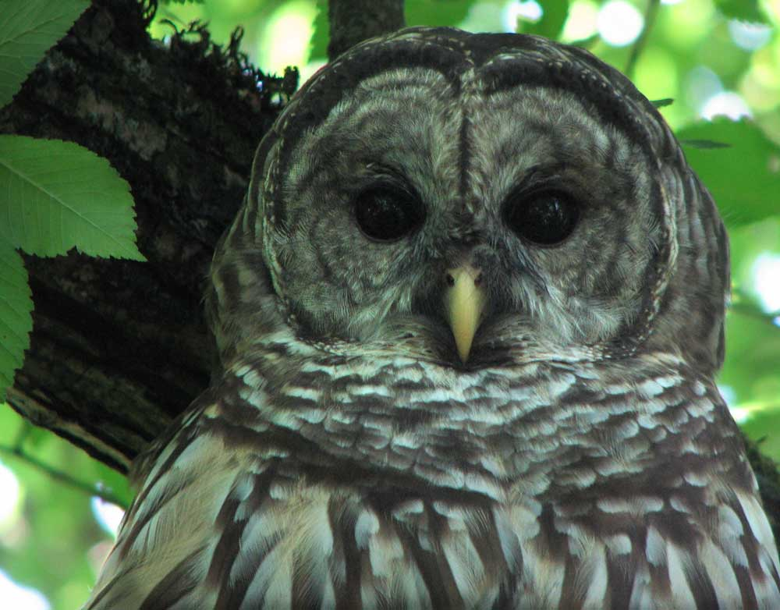


Thank You
Provisions
Regulating services
Habitat
Cultural
Aesthetic values
Notes:
The ecosystems that provide these benefits are often referred to as natural capital — the fields, farms, forests, wetlands and rivers within and surrounding our communities.
As biological creatures, we depend on nature to sustain the health and well-being of our families and communities. The planet’s stock of forests, oil, minerals, plants, animals, land and water are what keep us alive and well.
Provisions – nature gives us food, fuel, and fresh water.
Regulating services – nature purifies our water and regulates the temperature of our cities.
Habitat – ecosystems provide space for other species to live and interact, including the bees that pollinate our crops.
Cultural & aesthetic values – life today can be pretty hectic. Nature provides not only a space for recreation, it is a source of solace that provides significant health and psychological benefits. Few would argue the fact that the landscape of the lower mainland is one of the most beautiful in Canada.

Slide 22
Expanding Municipal Responsibilities dealing with Green Infrastructure (G.I.)
  Engineering/Transportation: stormwater management, ISMPs, road ROW landscape areas, floodplain mgmt., and detention areas
  Operations Management: drainage ditch management, detention & bio-filtration ponds, raingardens, & bio-swales, floodplain management
  Community /Development Planning: Town Centre Plan, “smart growth on ground” Green DP guidelines, amenity areas & services, arts/heritage, food security, Area Plans, Zoning Bylaw, DP Guidelines
  Environment: conservation protection areas, environmental DPs & ecological designs (LID), on site water management, hillside management, urban forest management, ecological restoration, & environmental outreach programs
  Recreation /Parks: active park lands, greenway corridors, open space areas, ‘communities in bloom’, street trees, trail corridors, maintenance of landscaping on public lands and urban forests
  Finance: green infrastructure budgets, securities, LAS Agreements, ongoing maintenance and life cycle replacement related costs

